Slide 1


Introduction to Modern App Development
Rockford Lhotka
CTO at Magenic
Level: Introduction

Slide 2
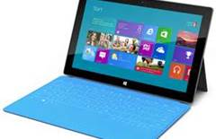

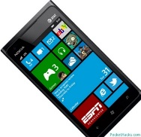
About Modern Apps Live!
Unique conference format
One “track” cutting across “tracks”
How to build modern apps end-to-end
ALM
Architecture
Design
Development
Testing
Leveraging your data

Slide 3
Primary Change Drivers
Touch and tablets
Personal integration
End of Moore’s Law (???)
Parallelization
Cloud data/processing
Social integration
Mobile devices

Slide 4
Assumed Constants
Consumers drive expectations
Enterprises move slowly
Natural monopoly effect
Enterprises need predictability

Slide 5
Impact
Client
Server (cloud)

Slide 6
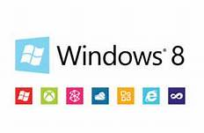
Windows 8
“Better Windows 7”
Faster and leaner than Windows 7
Compatible with Windows 7 apps
New programming platform
Windows Runtime (WinRT)
Microsoft Design Language (Modern UI)

Slide 7

iPad
Most popular tablet
Cause of most “BYOD”
Dev platform
Native Objective C
HTML 5
MonoTouch

Slide 8
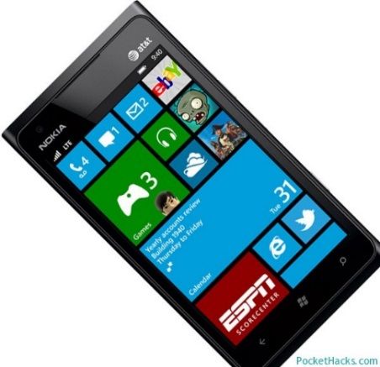
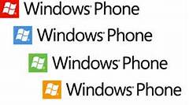
Windows Phone
Windows Phone 8
Windows 8 kernel
Dev platform
Windows Runtime (WinPRT)

Slide 9
Potential Server Futures
Cloud
Public
Private
Data centers
Fading away

Slide 10
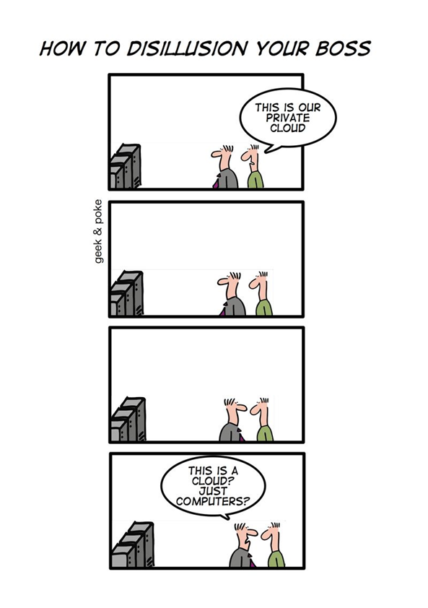

Slide 11



Cloud Computing Models
SOFTWARE
as a SERVICE
PLATFORM
as a SERVICE
INFRASTRUCTURE
as a SERVICE

Slide 12
MyVote App Architecture
iOS UI
WinPRT UI
WinRT UI
Reports
Excel
iOS BL
BL
BL
SQL Reporting
PowerPivot
Service Proxy
Data Portal
Data Portal
REST API
ASP.NET WA
Data Portal
BL
DAL
SQL Database
Blobs

Slide 13
MyVote Team
Rocky Lhotka
Architect/PM
Jason Bock
Business dev
Brent Edwards
XAML UI dev
Phil Lawson
XAML UI dev
Brian Randell
TFS/ALM lead
Jerry Falconer
Designer
Joe Gorman
QA/Test
Joshua Janssen
QA/Test
Steve Hughes
Data/BI
Kasey Schindler
iPad dev
Nathan Dupuis
Designer
Anthony Handley
Design lead
Billy Hollis
Design oversight
Aaron Notestad
XAML dev
Andy Tinkham
QA lead
Lou Miranda
iPad architect
Nick Landry
iPad advisor

Slide 14
Tools and Technologies
TFS (visualstudio.com)
Visual Studio 2012
Azure SDK
Azure Mobile SDK
Windows Phone 8 SDK
SQL Server Data Tools
Web tools 2012.2 (Web API)
Xcode/Objective C
Azure
Cloud services
SQL
Blob storage
Mobile services

Slide 15
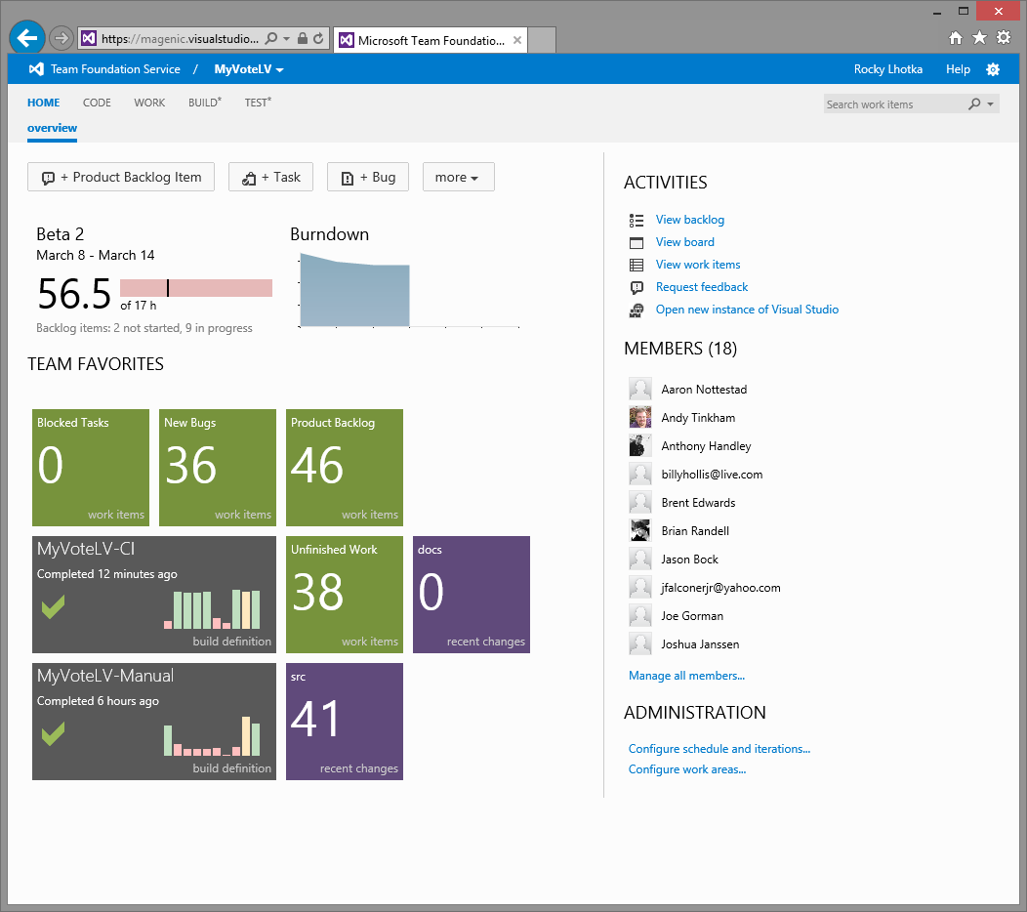
Project/Team Management

Slide 16
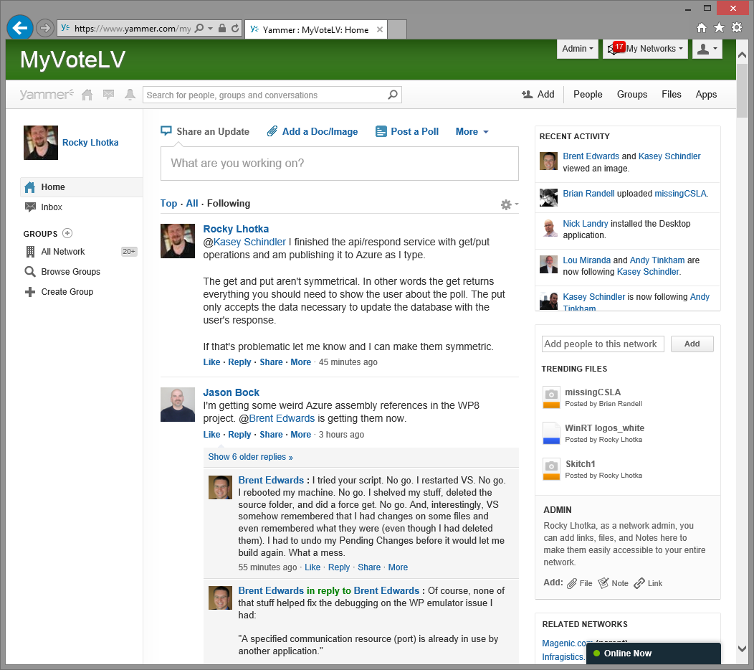
Distributed Communication

Slide 17
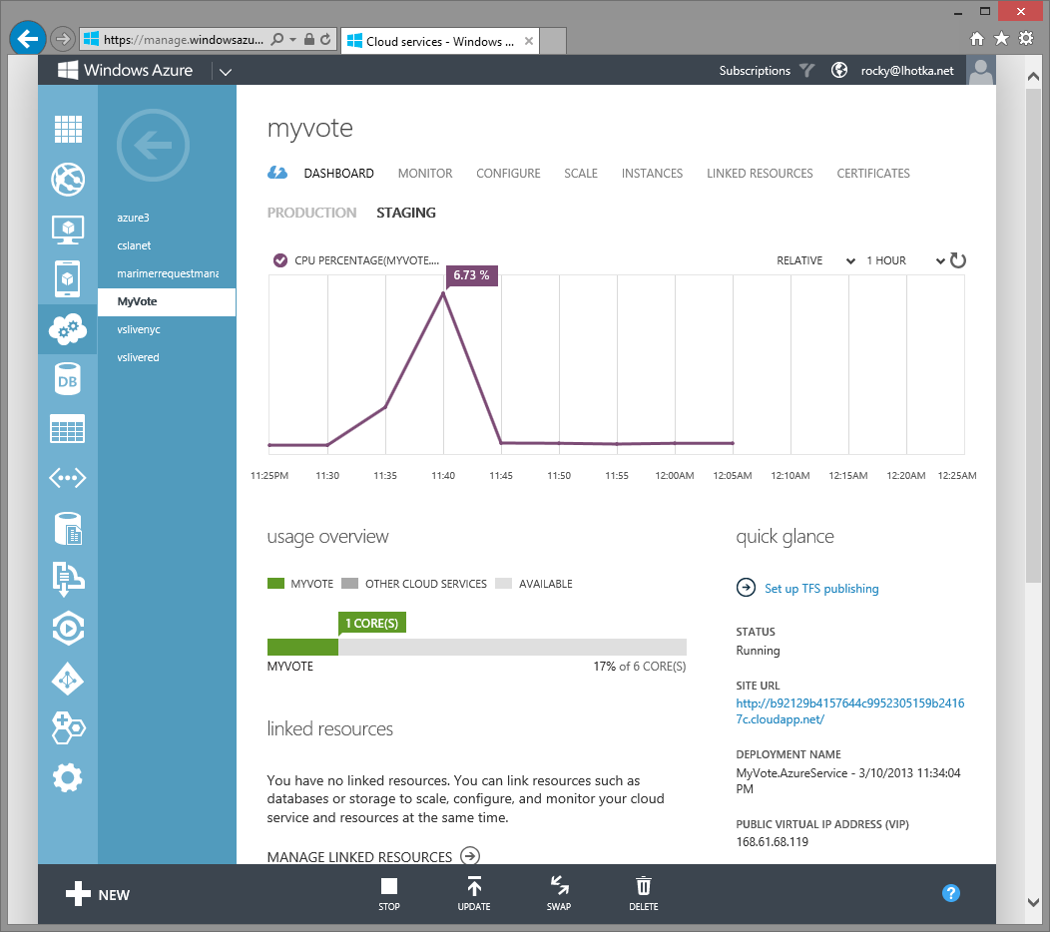
App Server

Slide 18
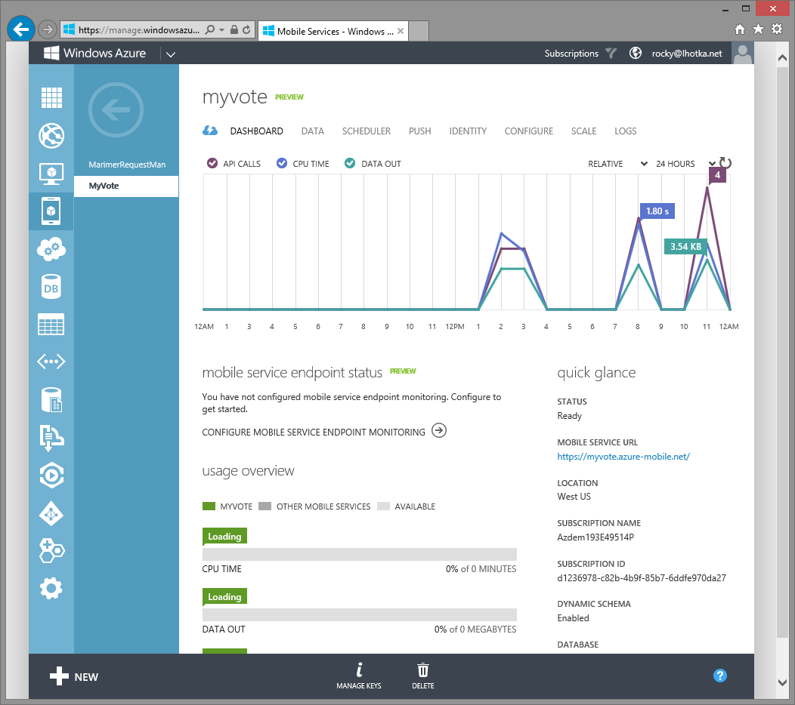
Mobile Services

Slide 19
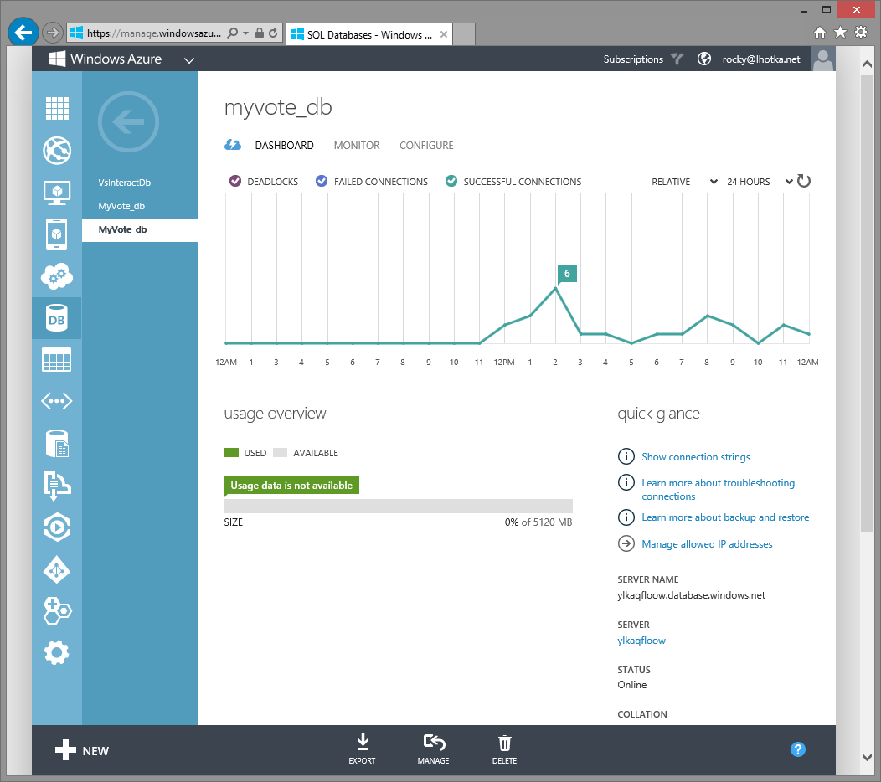
SQL Database

Slide 20
Modern App Walkthrough

Slide 21
Going Forward
TFS/ALM
Keynote: Steven Guggenheimer, Microsoft
Business Layer
Modern App Design
Developer Testing
Data Access and SQL Server
Application Server and Azure
User Experience Design
Windows 8 (WinRT) Client
Automated Testing
iPad Client
Windows Phone Client
Business Intelligence

Slide 22
Modern Apps: End-to-End

Slide 23
Thank you!
Rockford Lhotka
rockyl@magenic.com

